Slide 1

Elasticity and Its Application
Chapter 5

Slide 2
Elasticity
0
Basic idea: Elasticity measures how much one variable responds to changes in another variable.
One type of elasticity measures how much demand for your commodity will fall if you raise your price.
Definition: Elasticity is a numerical measure of the responsiveness of Q^{d} or Q^{s} to one of its determinants.
Notes:
Here, Q^{d} and Q^{s} are short for quantity demanded and quantity supplied, as in the PowerPoint for Chapter 4.

Slide 3
Price Elasticity of Demand
0
Price elasticity of demand
Percentage change in Q^{d}
=
Percentage change in P
Price elasticity of demand measures how much Q^{d} responds to a change in P.
Loosely speaking, it measures the price-sensitivity of buyers’ demand.

Slide 4
Price Elasticity of Demand
0
Price elasticity of demand
Percentage change in Q^{d}
=
Percentage change in P
P
Example:
P rises by 10%
Price elasticity of demand equals
P₂
P₁
D
15%
Q
= 1.5
Q₂
Q₁
10%
Q falls by 15%

Slide 5
Price Elasticity of Demand
0
Price elasticity of demand
Percentage change in Q^{d}
=
Percentage change in P
P
Along a D curve, P and Q move in opposite directions, which would make price elasticity negative.
We will drop the minus sign and report all price elasticities as positive numbers.
P₂
P₁
D
Q
Q₂
Q₁
Notes:
It might be worth explaining to your students that “P and Q move in opposite directions” means that the percentage change in Q and the percentage change in P will have opposite signs, thus implying a negative price elasticity.
To be consistent with the text, the last statement in the green box says that we will report all price elasticities as positive numbers. It might be slightly more accurate to say that we will report all elasticities as non-negative numbers: we want to allow for the (admittedly rare) case of zero elasticity.

Slide 6
Calculating Percentage Changes
0
Standard method of computing the percentage (%) change:
Demand for your websites
end value – start value
P
x 100%
start value
B
$250
A
Going from A to B, the % change in P equals
$200
D
($250–$200)/$200 = 25%
Q
8
12

Slide 7
Calculating Percentage Changes
0
Problem:
The standard method gives different answers depending on where you start.
Demand for your websites
P
From A to B, P rises 25%, Q falls 33%, elasticity = 33/25 = 1.33
From B to A, P falls 20%, Q rises 50%, elasticity = 50/20 = 2.50
B
$250
A
$200
D
Q
8
12

Slide 8
Calculating Percentage Changes
0
So, we instead use the midpoint method:
end value – start value
x 100%
midpoint
The midpoint is the number halfway between the start & end values, the average of those values.
It doesn’t matter which value you use as the “start” and which as the “end” – you get the same answer either way!

Slide 9
Calculating Percentage Changes
0
Using the midpoint method, the % change in P equals
$250 – $200
x 100%
= 22.2%
$225
The % change in Q equals
12 – 8
x 100%
= 40.0%
10
The price elasticity of demand equals
40/22.2 = 1.8
Notes:
These calculations are based on the example shown a few slides back: points A and B on the website demand curve.

Slide 10
The Elasticity of Demand
Midpoint method
Two points: (Q₁, P₁) and (Q₂, P₂)

Slide 11
A C T I V E L E A R N I N G 1 Calculate an elasticity using mid point method
Use the following information to calculate the price elasticity of demand for hotel rooms:
if P = $70, Q^{d} = 5000
if P = $90, Q^{d} = 3000

Slide 12
EXAMPLE: Insulin vs. Caribbean Cruises
0
The prices of both of these goods rise by 20%. For which good does Q^{d} drop the most? Why?
To millions of diabetics, insulin is a necessity. A rise in its price would cause little or no decrease in demand.
A cruise is a luxury. If the price rises, some people will forego it.
Lesson: Price elasticity is higher for luxuries than for necessities.

Slide 13
The Determinants of Price Elasticity:
0
Availability of close substitutes
Goods with close substitutes
More elastic demand
Necessities vs. luxuries
Necessities – inelastic demand
Luxuries – elastic demand
Definition of the market
Narrowly defined markets – more elastic demand
Time horizon
More elastic over longer time horizons
Notes:
This slide is a convenience for your students, and replicates a similar table from the text.
If you’re pressed for time, it is probably safe to omit this slide from your presentation.

Slide 14
The Variety of Demand Curves
0
The price elasticity of demand is closely related to the slope of the demand curve.
Rule of thumb: The flatter the curve, the bigger the elasticity. The steeper the curve, the smaller the elasticity.
Five different classifications of D curves.…
Notes:
Economists classify demand curves according to their elasticity.
The next 5 slides present the five different classifications, from least to most elastic.

Slide 15
“Perfectly inelastic demand” (one extreme case)
0
Price elasticity of demand
% change in Q
0%
=
=
= 0
% change in P
10%
D curve:
P
D
vertical
P₁
Consumers’ price sensitivity:
P₂
none
P falls by 10%
Q
Elasticity:
Q₁
0
Q changes by 0%
Notes:
If Q doesn’t change, then the percentage change in Q equals zero, and thus elasticity equals zero.
It is hard to think of a good for which the price elasticity of demand is literally zero. Take insulin, for example. A sufficiently large price increase would probably reduce demand for insulin a little, particularly among people with very low incomes and no health insurance.
However, if elasticity is very close to zero, then the demand curve is almost vertical. In such cases, the convenience of modeling demand as perfectly inelastic probably outweighs the cost of being slightly inaccurate.

Slide 16
“Inelastic demand”
0
Price elasticity of demand
% change in Q
< 10%
=
=
< 1
% change in P
10%
D curve:
P
relatively steep
P₁
Consumers’ price sensitivity:
P₂
relatively low
D
P falls by 10%
Q
Elasticity:
Q₁
Q₂
< 1
Q rises less than 10%
Notes:
An example: Student demand for textbooks that their professors have required for their courses.
Here, it’s a little more clear that elasticity would be small, but not zero. At a high enough price, some students will not buy their books, but instead will share with a friend, or try to find them in the library, or just take copious notes in class.
Another example: Gasoline in the short run.

Slide 17
“Unit elastic demand”
0
Price elasticity of demand
% change in Q
10%
=
=
= 1
% change in P
10%
D curve:
P
intermediate slope
P₁
Consumers’ price sensitivity:
P₂
intermediate
D
P falls by 10%
Q
Elasticity:
Q₁
Q₂
1
Q rises by 10%
Notes:
This is the intermediate case: the demand curve is neither relatively steep nor relatively flat. Buyers are neither relatively price-sensitive nor relatively insensitive to price.
(This is also the case where price changes have no effect on revenue.)

Slide 18
“Elastic demand”
0
Price elasticity of demand
% change in Q
> 10%
=
=
> 1
% change in P
10%
D curve:
P
relatively flat
P₁
Consumers’ price sensitivity:
P₂
D
relatively high
P falls by 10%
Q
Elasticity:
Q₁
Q₂
> 1
Q rises more than 10%
Notes:
A good example here would be breakfast cereal, or nearly anything with readily available substitutes.
An elastic demand curve is flatter than a unit elastic demand curve (which itself is flatter than an inelastic demand curve).

Slide 19
“Perfectly elastic demand” (the other extreme)
0
Price elasticity of demand
% change in Q
any %
=
=
= infinity
% change in P
0%
D curve:
P
horizontal
P₂ =
P₁
D
Consumers’ price sensitivity:
extreme
P changes by 0%
Q
Elasticity:
Q₁
Q₂
infinity
Q changes by any %
Notes:
“Extreme price sensitivity” means the tiniest price increase causes demand to fall to zero.
“Q changes by any %” – when the D curve is horizontal, quantity cannot be determined from price. Consumers might demand Q1 units one month, Q2 units another month, and some other quantity later. Q can change by any amount, but P always “changes by 0%” (i.e., doesn’t change).
If perfectly inelastic is one extreme, this case (perfectly elastic) is the other.
Here’s a good real-world example of a perfectly elastic demand curve, which foreshadows an upcoming chapter on firms in competitive markets. Suppose you run a small family farm in Iowa. Your main crop is wheat. The demand curve in this market is downward-sloping, and the market demand and supply curves determine the price of wheat. Suppose that price is $5/bushel.
Now consider the demand curve facing you, the individual wheat farmer. If you charge a price of $5, you can sell as much or as little as you want. If you charge a price even just a little higher than $5, demand for YOUR wheat will fall to zero: Buyers would not be willing to pay you more than $5 when they could get the same wheat elsewhere for $5. Similarly, if you drop your price below $5, then demand for YOUR wheat will become enormous (not literally infinite, but “almost infinite”): if other wheat farmers are charging $5 and you charge less, then EVERY buyer will want to buy wheat from you.
Why is the demand curve facing an individual producer perfectly elastic? Recall that elasticity is greater when lots of close substitutes are available. In this case, you are selling a product that has many perfect substitutes: the wheat sold by every other farmer is a perfect substitute for the wheat you sell.

Slide 20
The Elasticity of Demand
Total revenue
Amount paid by buyers
Received by sellers of a good
Computed as: price of the good times the quantity sold (P ˣ Q)

Slide 21
Total revenue
2
Price
1. an
$4
P ˣ Q=$400
(revenue)
Demand
P
0
100
Quantity
Q
The total amount paid by buyers, and received as revenue by sellers, equals the area of the box under the demand curve, P × Q. Here, at a price of $4, the quantity demanded is 100, and total revenue is $400.

Slide 22
The Elasticity of Demand
Total revenue and price elasticity of demand
Inelastic demand
Increase in price
Increase in total revenue
Elastic demand
Increase in price
Decrease in total revenue

Slide 23
How total revenue changes when price changes (a)
3
(a) The Case of Inelastic Demand
Price
Price
1. an
1. an
$3
Revenue=$240
$1
Demand
Demand
Revenue=$100
0
100
Quantity
0
80
Quantity
The impact of a price change on total revenue (the product of price and quantity) depends on the elasticity of demand. In panel (a), the demand curve is inelastic. In this case, an increase in the price leads to a decrease in quantity demanded that is proportionately smaller, so total revenue increases. Here an increase in the price from $1 to $3 causes the quantity demanded to fall from 100 to 80. Total revenue rises from $100 to $240

Slide 24
How total revenue changes when price changes (b)
3
(b) The Case of Elastic Demand
Price
Price
1. an
1. an
$5
$4
Revenue
=$200
Revenue=$100
Demand
Demand
0
50
Quantity
0
20
Quantity
The impact of a price change on total revenue (the product of price and quantity) depends on the elasticity of demand. In panel (b), the demand curve is elastic. In this case, an increase in the price leads to a decrease in quantity demanded that is proportionately larger, so total revenue decreases. Here an increase in the price from $4 to $5 causes the quantity demanded to fall from 50 to 20. Total revenue falls from $200 to $100.
.

Slide 25
The Elasticity of Demand
When demand is inelastic
Price and total revenue move in the same direction
When demand is elastic
Price and total revenue move in opposite directions
If demand is unit elastic
Total revenue remains constant when the price changes

Slide 26
Other Elasticities
Income elasticity of demand: measures the response of Q^{d} to a change in consumer income
Income elasticity of demand
Percent change in Q^{d}
=
Percent change in income
∆q
----------
q
= -----------------
∆Y
-------
Y
Income elasticity of
demand
Notes:
This topic and the next one (cross-price elasticity) do not appear anywhere else in the book. Instructors who are pressed for time may consider cutting these topics.
(This is merely my suggestion, not the official position of Greg Mankiw or Cengage/South-Western.)

Slide 27
Income elasticity of demand schedule
Income (Y) | Qd
500 | 20
600 | 25
∆Y= 100 | ∆q= 5

Slide 28
∆q
----------
q
EY= -----------------
∆Y
-------
Y
5
----------
20
EY= -----------------
100
-------
500

Slide 29
EY= 1.25
Or
EY>1

Slide 30
Income Elasticity
Types of Goods
Normal Goods
Inferior Goods
Higher income raises the quantity demanded for normal goods but lowers the quantity demanded for inferior goods.

Slide 31
Income Elasticity
Goods consumers regard as necessities tend to be income inelastic
Examples include food, fuel, clothing, utilities, and medical services.
Goods consumers regard as luxuries tend to be income elastic.
Examples include sports cars, furs, and expensive foods.

Slide 32
Other Elasticities
Cross-price elasticity of demand: measures the response of demand for one good to changes in the price of another good
Cross-price elast. of demand
% change in Q^{d} for good 1
=
% change in price of good 2
For substitutes, cross-price elasticity > 0 (e.g., an increase in price of beef causes an increase in demand for chicken)
For complements, cross-price elasticity < 0 (e.g., an increase in price of computers causes decrease in demand for software)

Slide 33
Cross Elasticity of Demand
Under cross elasticity of demand (EC) change in the price of (B) Commodity results a change in the demand for commodity (A), While the Price of (A) remains the same.

Slide 34
Computing Income Elasticity
Cross elasticity of
demand
∆qA
----------
qA
= -----------------
∆pB
-------
pB

Slide 35
Cross elasticity of demand schedule
Commodities | Price (Rs) for 40 kg | Qd kg
Wheat A PA | 1600 | 40
 |  | 50 10= ∆qA
Rice B PB | 2000
 | 2500 500= ∆pB

Slide 36
∆qA
----------
qA
EC= -----------------
∆pB
-------
pB
10
----------
40
EC= -----------------
500
-------
2000

Slide 37
EC= 1
Or
Equal to unity

Slide 38
Elasticity of supply
This measures the responsiveness of quantity supplied to a change in price.
The price elasticity of supply (PES) is measured by
% change in Q.S / % change in price.
If price of a apple increases 10%, and the supply increases 20%. We say the PES is 2.0
If the price of bananas falls 12% and the quantity supplied falls 2%. We say the PES = 2/12 = 0.16

Slide 39
Price Elasticity of Supply
0
Price elasticity of supply
Percentage change in Q^{s}
=
Percentage change in P
P
Example:
S
P rises by 8%
Price elasticity of supply equals
P₂
P₁
Q
16%
Q₁
Q₂
= 2.0
8%
Q rises by 16%

Slide 40
Time period important
Short time- little adjustment possible as in short run supply can be changed only up to certain limit it depends upon the quantity available in stock, provision of an extra shift in production unit and existing productive capacity of the industry. In this period neither new firm can be established nor the exist size of the firm can be changed.

Slide 41
Long time – lots of adjustment possible
In long period there is sufficient time to change the size of the existing plant and new firm can also be established. There is a big scope of extraction or contraction of supply due to changing requirements in demand.

Slide 42
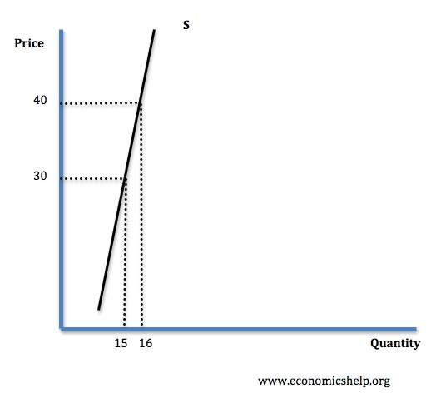
Inelastic supply
This means that an increase in price leads to a smaller % change in supply. Therefore PES <1

Slide 43
Supply could be inelastic for the following reasons
Firms operating close to full capacity.
Firms have low levels of stocks, therefore there are no surplus goods to sell
In the short term, capital is fixed in the short run e.g. firms do not have time to build a bigger factory.
If it is difficult to employ factors of production, e.g. if highly skilled labour is needed
With agricultural products supply is inelastic in the short run, because it takes at least six months to grow crops, in September the farmer cannot suddenly produce more potatoes if the price goes up.

Slide 44
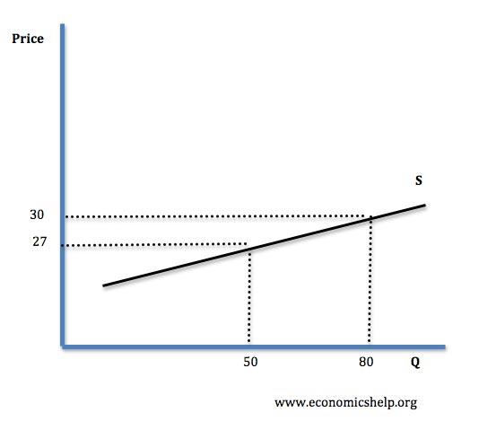
Elastic supply
This occurs when an increase in price leads to a bigger % increase in supply, therefore PES >1

Slide 45
Supply could be elastic for the following reasons
If there is spare capacity in the factory.
If there are stocks available.
In the long run supply will be more elastic because capital can be varied.
If it is easy to employ more factors of production.

Slide 46
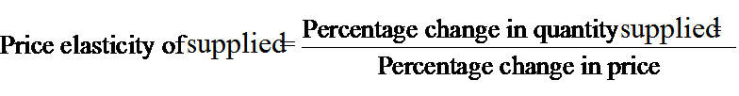
Computing the Price Elasticity of Demand
Percentage method
The price elasticity of supply is computed as the percentage change in the quantity supplied divided by the percentage change in price.

Slide 47
Formula method
∆qs
----------
qs
E= -----------------
∆P
-------
P
It can be measured with the help of following formula:

Slide 48
Example
Price (P) | Qs
10 | 20
12 | 24
∆P= 2 | ∆qs= 4

Slide 49
∆qs
----------
qs
E= -----------------
∆P
-------
P
4
----------
20
E= -----------------
2
-------
10
E = 1

